Slide 1
t-SNE
t-distributed stochastic neighbor embedding
第四組:鄭家豪、陳煒傑、陳振峰
2023 05 25

Slide 2
Table of content
1.Introduction
2.t-SNE
3.How does work t-SNE?
4.Demo t-SNE(take MNIST and Iris dataset for example)
5.Question
-Appendix
-Resource

Slide 3
Introduction

Slide 4
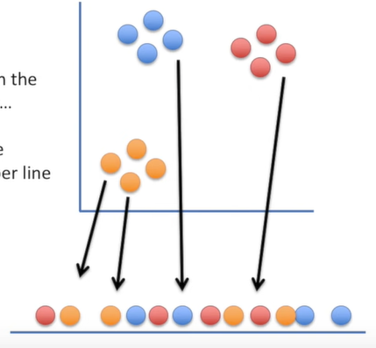
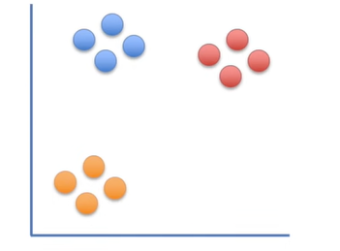




Main Objective:*
* Illustration is in 2-D only for illustration simplicity, t-SNE also works for higher dimension
Then we’ll put the points on the number line in a random order
We’ll start with the original scatter plot
From here on out, t-SNE moves these points, a little bit at a time, until it has clustered them

Slide 5
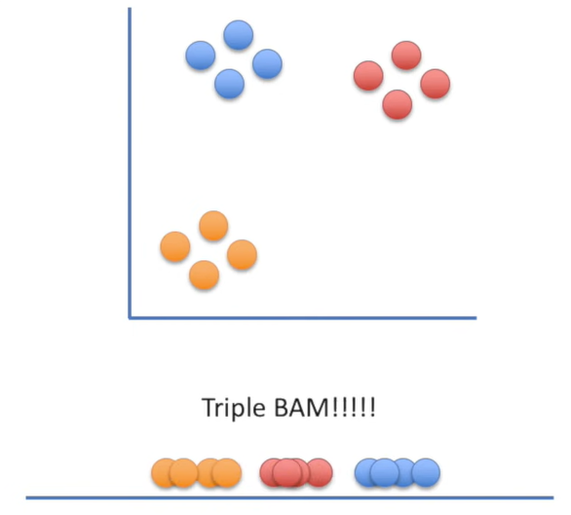


At each step, a point on the line is attracted to points it is near in the scatter plot, and repelled by points it is far from

Slide 6
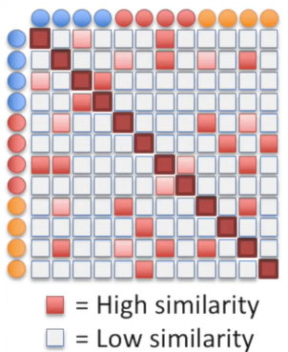
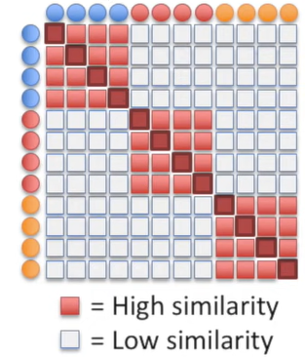
=
=

Slide 7
t-SNE

Slide 8
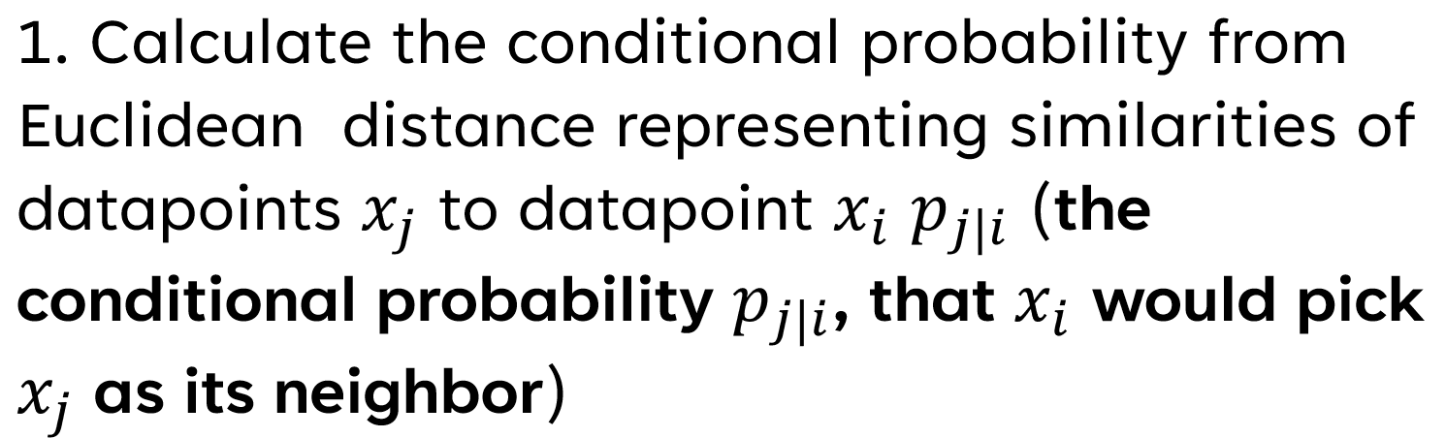



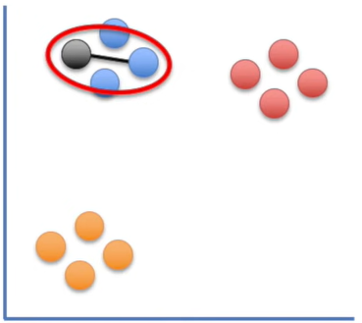
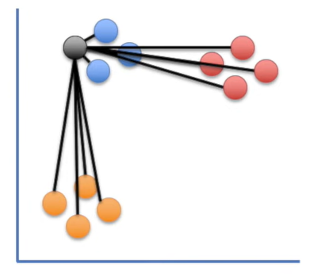
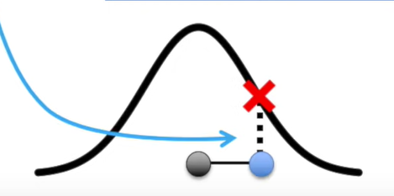

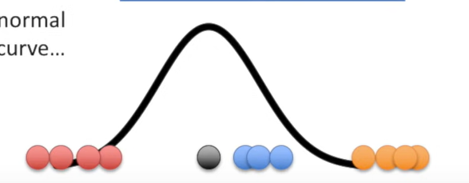
by Hinton and Roweis, 2002
Scaling to account for different densities of datapoints

Slide 9
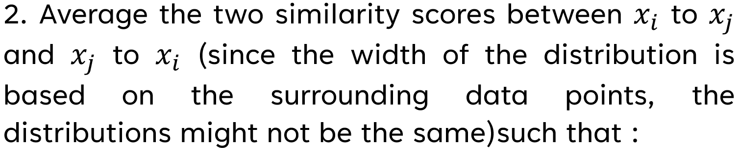
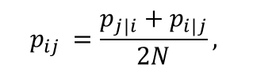
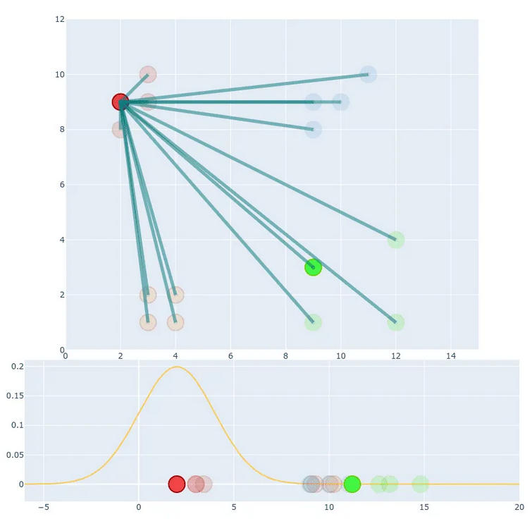
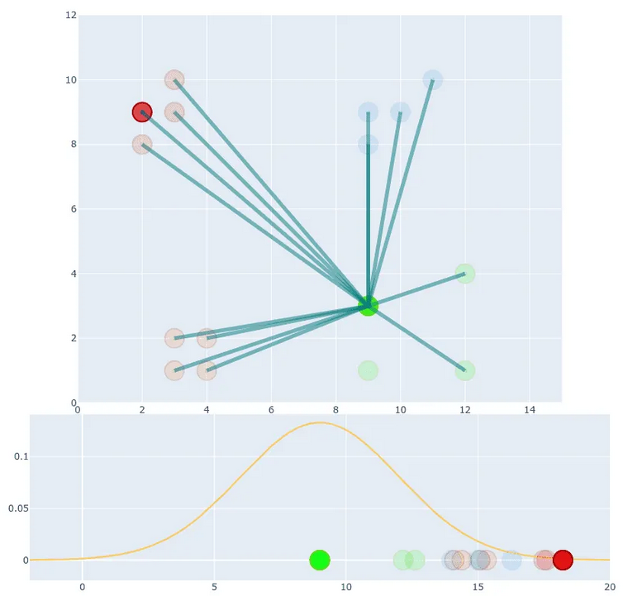

Where N is the number of observations
After this definition, the effect of outliers on the cost function will not be very little.
≠

Slide 10
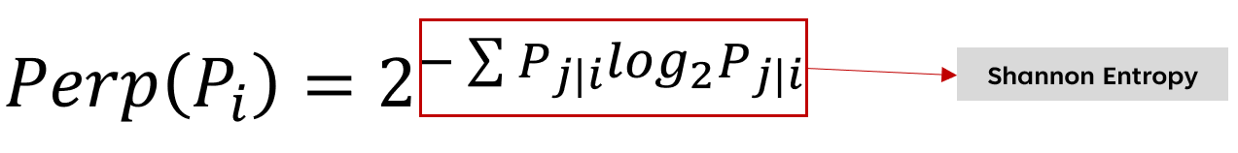
3. Select Perplexity (cost-function hyperparameter);
A perplexity is a target number of neighbors for our central point. Basically, the higher the perplexity is ,the higher value variance has.(that is ,the data points are uniformly scattered)
In dense regions, a smaller value of perplexity is usually more appropriate in sparser regions. (that is,data points are from vary(peaks or valleys) distribution)
Quoting the original paper: “SNE performs a binary search for the value of sigma that produces probability distribution with a fixed perplexity that is specified by the user”.
Typically,the perplexity are between 5 and 50.

Slide 11
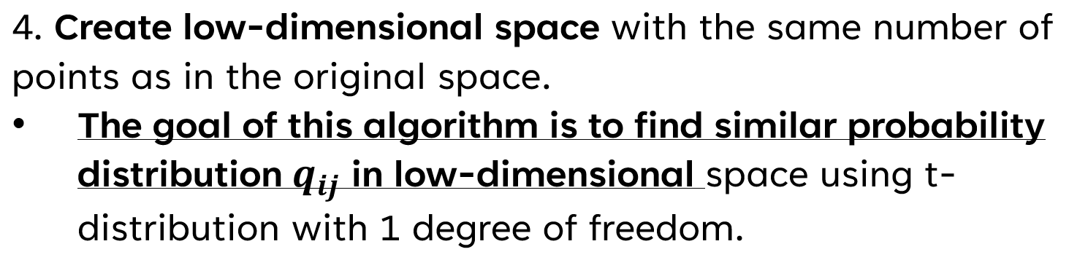
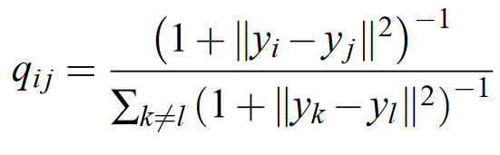
The equation is given by:
Note:The count of distance be calculated is (N*(N-1))/2

Slide 12

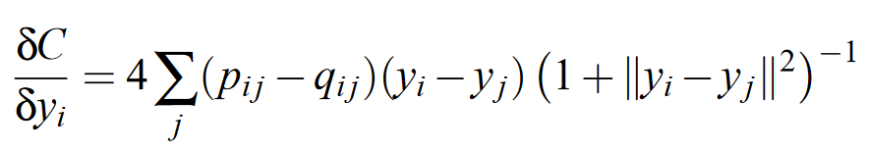
5. Gradient Descent;
To optimize, we want to minimize the sum of Kullback-Leibler(cost function) divergences:
Take the derivative of equation above and solve we get:(see appendix)

Slide 13
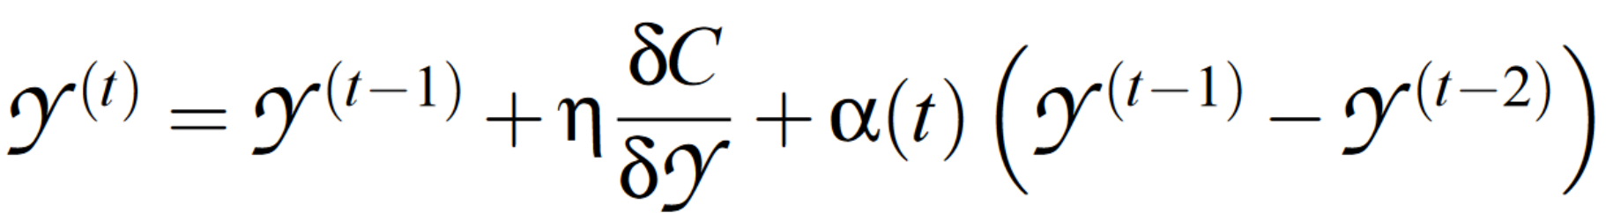
In order to speed up the optimization and to avoid poor local minima, a relatively large momentum is added to the gradient:
,where
r^{(t)}= low dimension solution at iteration t,
and η = the learning rate,
α(t) = the momentum at iteration t
are the optimization parameter

Slide 14
Why we use t-distribution instead of Gaussian distribution?
Crowding Problems: “The area of the two-dimensional map that is available to accommodate moderately distant datapoints will not be nearly large enough compared with the area available to accommodate nearby datapoints.”
When we model a high-dimensional dataset in 2 (or 3) dimensions, it is difficult to segregate the nearby datapoints from moderately distant datapoints and gaps can not form between natural clusters.
In the high-dimensional space, we convert distances into probabilities using a Gaussian distribution. In the low-dimensional map, we can use a probability distribution that has much heavier tails (like t-distribution,Cauchy distribution).
This way moderate distance in high-dimensional space can be modeled by larger distance in low-dimensional space.

Slide 15
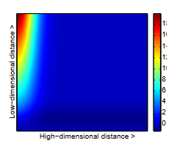
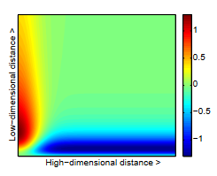
First note that the t-SNE gradient strongly repels dissimilar datapoints that are modeled by a small pairwise distance in the low-dimensional representation.
SNE has such a repulsion as well, but its effect is minimal compared to the strong attractions elsewhere in the gradient
t-SNE puts emphasis on :
Modeling dissimilar datapoints by means of large pairwise distances
Modeling similar datapoints by means of small pairwise distances.
SNE
t-SNE
Positive values of the gradient represent an attraction between the low-dimensional two datapoints whereas negative values represent a repulsion between the two datapoints.

Slide 16
A brief summary of t-SNE
Early compression
Early exaggeration
Force the map points to stay close together at the start of the optimization by implementing an L2-penalty term to the cost function proportional to the sum of the squared distance of datapoints from the origin.
When the distances between map points are small, it is easy for clusters to move through one another so it is much easier to explore the space of possible global organizations of the data
Scale using a scalar all the p_{i|j}'s so that large q_{i|j}'s are obtained with the effect that natural clusters in the data form tight, widely separated clusters as a lot of empty space is created in the low-dimensional space.
This creates a lot of relatively empty space in the map, which makes it much easier for the clusters to move around relative to one another in order to find a good global organization.

Slide 17
Pros
Cons
Preserves local and global structure of high-dimensional data: points which are close to one another in the high-dimensional data set will tend to be close to one another in the low-dimensional map
Great for Exploratory Data Analysis (e.g. whether we want to know if the data is separable or not)
Not great for machine learning application, mainly used for data visualization; t-SNE is not learning a function from the original space to the new (lower) dimensional one.
Non-convexity of t-SNE cost function; in other words, t-SNE algorithm is not deterministic
Tricky interpretation

Slide 18
How does t-SNE work?

Slide 19
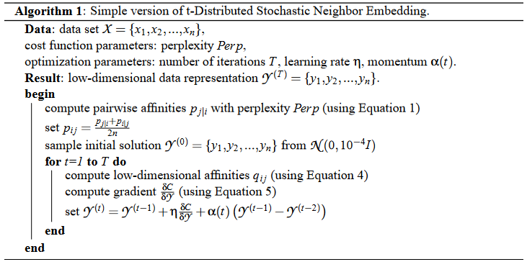
Algorithm Application

Slide 20
Demo t-SNE

Slide 21
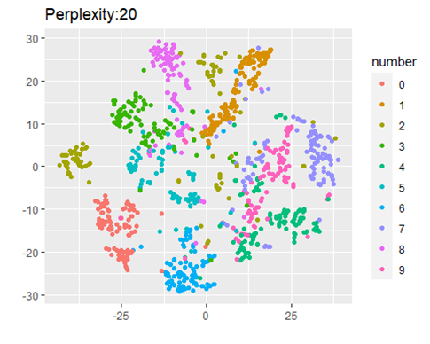
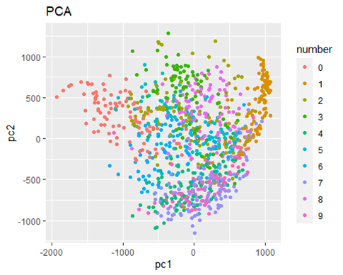
Demo1: MNIST data set

Slide 22
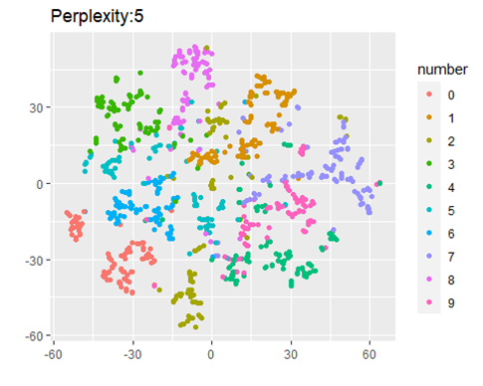
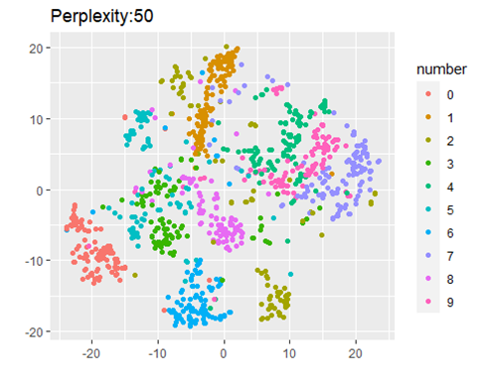
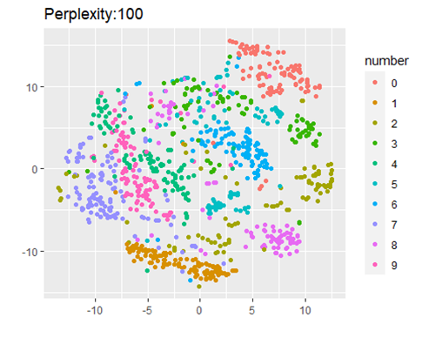

Slide 23
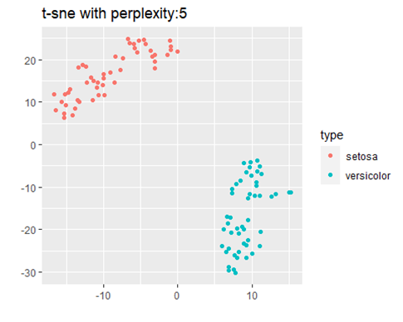
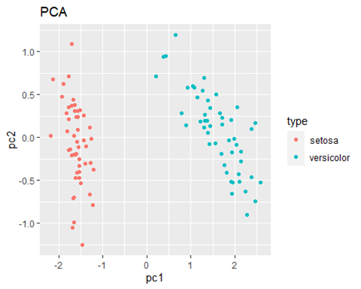
Demo2: IRIS data set

Slide 24
Question

Slide 25
Question
1.For S={S1,S2,S3,S4} with P(S1) = 1/4,P(S2)=1/8,P(S3)=1/2,P(S4)=1/8,
calculate Shannon entropy with base 2.
2.Which followings about t-SNE are true?
(A)In low-dimension space,t-SNE usually has a more severe crowding problem than SNE.
(B)We can use Gamma distribution rather than t distribution to compute similarity between two points in low-dimension space.
(C)The heavy-tailed distribution (support is real number set) is employed to alleviate crowding problem and optimization problem in low-dimension space.
(D)The cost function is symmetric.
(E)The choice for heavy-tailed distribution can be Student t , Cauchy.
(F)all of the above; (G) none of the above

Slide 26
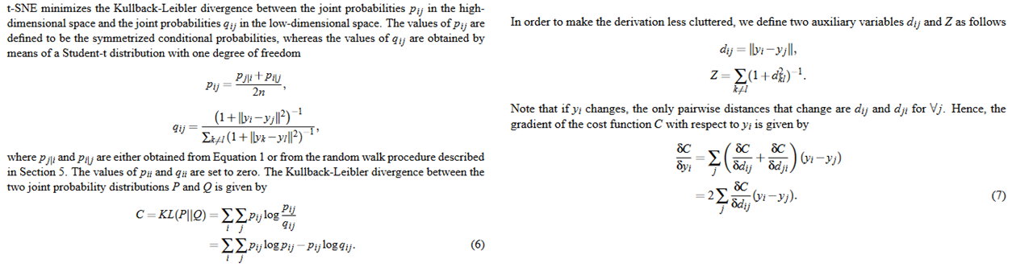
Appendix
Derivation of t-SNE gradient

Slide 27
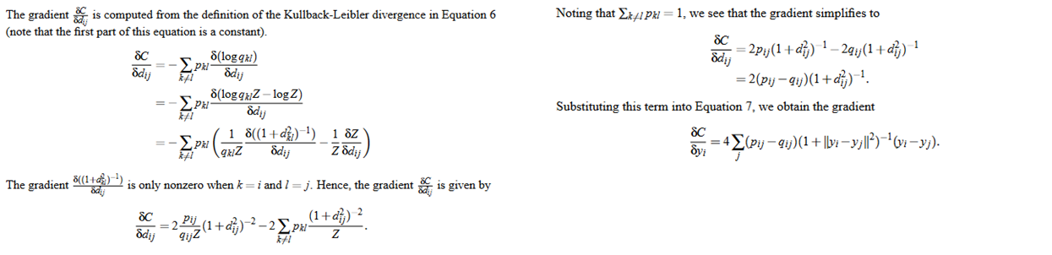

Slide 28
RESOURCE
Maaten, L. van der, & Hinton, G. (2008). Visualizing Data using t-SNE. Journal of Machine Learning Research, 9, 2579–2605.
Erdem (burnpiro), Kemal. “T-SNE Clearly Explained.” Medium, July 21, 2022. https://towardsdatascience.com/t-sne-clearly-explained-d84c537f53a.
YouTube. (2013). Visualizing Data Using t-SNE. YouTube. Retrieved May 24, 2023, from https://www.youtube.com/watch?v=RJVL80Gg3lA&amp;t=750s&amp;pp=ygUFdCBzbmU%3D.
How to Use t-SNE Effectively https://distill.pub/2016/misread-tsne/

